Slide 1
R&D Project Team Culture and Conflict Resolution
Week 4

Slide 2
Agenda items
Team Culture for R&D Projects
Conflict Resolution

Slide 3
Team Culture
It's how team members work together towards a common goal and how they will treat each other in the project.
A team must develop its culture based on shared values, beliefs, attitudes, and behaviors.
  Values are worthy ideas to adopt to be successful in your R&D projects –
  Team values-
  Collective attendance for all R&D project ceremonies (workshops, meetings, etc.
  Team diversity- respecting team members (cultural background, country of origin, gender, study major, skills level & their multiple strengths, etc.
  Working closely with the team members, client, mentor, and key stakeholders
  Open discussions, face-to-face interaction & communication, feedback, & individual contribution will be valued
  Continuous learning, upskilling & learning from one another, coaching/mentoring each other
  Beliefs are assumptions and convictions held to be true based on past experiences of the adopted PM methodology
  Collective planning & scheduling
  Collective effort and task sharing
  Adopt short work cycles for the entire project
  Regularly monitoring/controlling work to measure progress and provide visibility in the project
  Deliver value for the client- regular client meetings & feedback, status updates, and continuous and regular delivery of artifacts
  Maintain a consistent work pace- between 12 to 15 hours per week throughout the project until the competition

Slide 4
Team Culture
  Attitude (values + beliefs)- what the team can do and will do
  Plan, commit and deliver for the day, week, short cycles, etc.
  Learn new technical and non-technical skills on the fly to deliver work
  Deliver work with quality (bug-free and valuable features)
  Provide project status in a real-time
  Behaviours (because of the above three)- trust, conflict resolution, commitment, accountability, & result-driven
  Trust- Be transparent and honest with each other with work and can share any information (not mocked, dismissed, or used against).
  Conflict resolution- is about having a constructive and productive debate of ideas and possible options on issues.
  Commitment- full buy-in and commitment to plans & decisions.
  Accountability- having a clear plan of action and willing to be accountable
  Result-driven- produce the work that you have planned and committed.

Slide 5
Team Culture
What would be your team culture?
Culture that brings the best project outcome for all (3 key) stakeholders
Have you addressed this in your proposal or are all of you on same page?

Slide 6
Team Culture
If you are not being explicit now, your team culture will be established anyway
You could be establishing a culture that has:
  A lack of commitment to the project
  A lack of motivation to do consistent work on the project
  A lack of ability to produce deliverables on time
  A lack of visibility in the project work
  A failure to apply the practices you say you are using
  A failure to keep records of what is done, is in progress, or on backlog
  A lack of quality- a failure to apply any quality assurance or control processes
Then will be disengagement in the project and will come the external pressure

Slide 7
Culture for a self-organizing (self-managing) team
Self-organizing team
  Team collectively plans and manages work, associated responsibilities and timeline (schedule)
  Not dependent or micro-managed
  Individuals take initiative (leadership in tasks)
  Establishes a working relationship with all stakeholders
  Respect and trust each other & stakeholders
  Co-located to have solid teamwork and collaboration
  Team members are communicating/interacting and working effectively
  Attitude for learning and upskilling on the fly
  Coach and mentor each other
  Continuously focuses on improvement and growth
  Collectively take ownership of tasks and deliverables

Slide 8
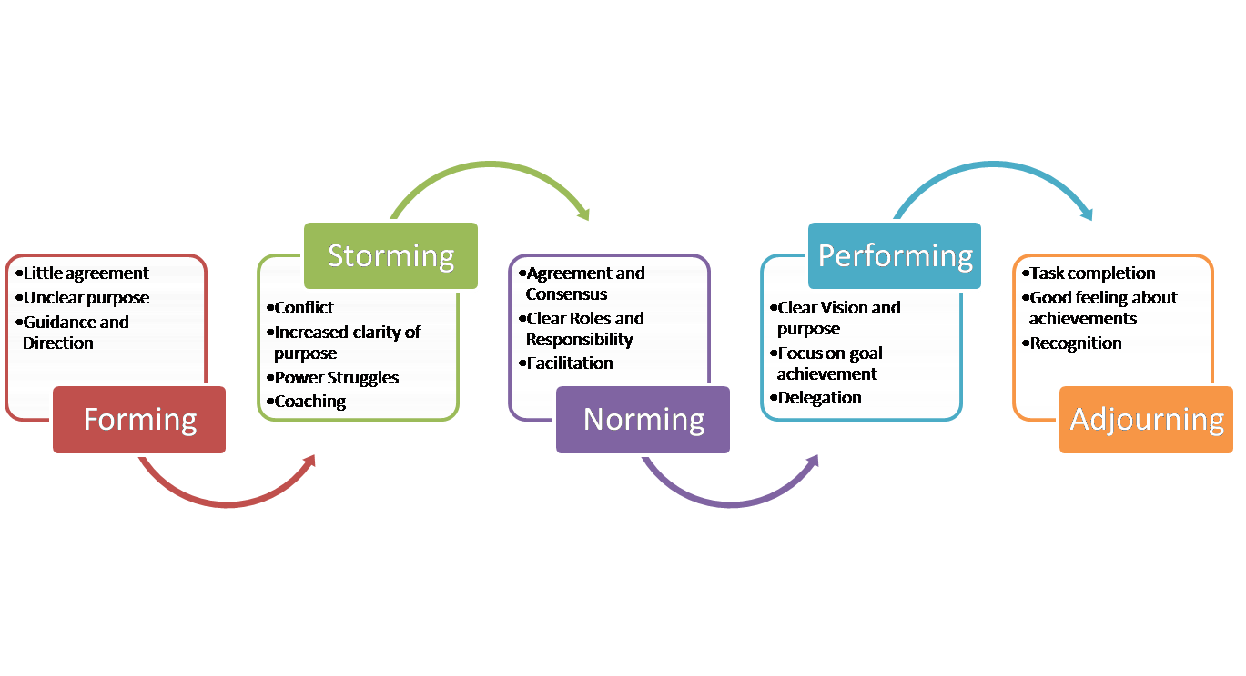
Stages to become a self-organizing team
Tuckman & Jensen (1977). Stages of small-group development revisited. Group & Organization Management, 2(4), 419 – 427.

Slide 9
The storming phase
Normally tension, struggle, and sometimes arguments occur
Can lower motivation if allowed to get out of control
Some teams will never develop past this stage
However, disagreements within the team can make members stronger, more versatile, and able to work more effectively as a team
If team members are able to transition from an individual to a team focus and resolve their differences, members will be able to participate with one another more comfortably

Slide 10
Team building tips/ideas
Social time for team building (on-going- fun time, no project work)
Stick together as a team (for tasks, success and failures)
Understand yourself
Understand others
Define clear team roles
Team learning, upskilling, coaching and mentoring
Set the ground rules for expected behaviour
Continuous reflection and feedback to get better- be objective, be clear it is not about the blame game
A clear conflict resolution process

Slide 11
What is conflict?
A difference of opinion with strong feelings or ego attached
- Ed McKinley & Glen Ochre - (Groupwork Institute of Australia)
Shows up in a range of ways or behaviours such as disagreements, opposed views, confusion, uncomfortable feelings, silence, poor performance, rework, distrust, and disengagement.
Conflict can have both positive and negative outcomes. On the positive side, conflict can result in greater creativity or better decisions.

Slide 12

Positive outcomes
Consideration of a broader range of ideas, resulting in a better, stronger ideas
Surfaces assumptions that may be inaccurate
Increased participation and creativity
Clarification of individual views that build learning
More buy-in and ownership of the outcomes

Slide 13
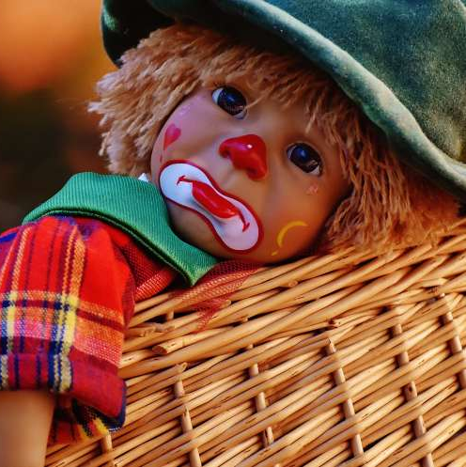
Negative outcomes
Increased stress and anxiety among individuals, which decreases productivity and satisfaction
Feelings of being defeated and demeaned, which lowers individuals’ morale and may increase turnover
A climate of mistrust, which hinders the teamwork and cooperation necessary to get work done

Slide 14
Prevention and early intervention
Create a safe work environment for your group work early on
Be on the lookout for and attend to conflict straight away
Trust the group’s collective intelligence - groups can work through any conflict if are committed
Monitor your group - weekly, daily, hourly, right now!

Slide 15
Do you have a conflict resolution process to address when:
Someone is not coming to meetings or workshops
Is delivering poor-quality work
Isn’t reviewing others’ work with any care
You have a strong dominant personality and silent others
When strong opposing views surface
Someone is not pulling their weight or meeting agreed deadlines
You have failed to achieve the team result you wanted
Are falling behind schedule
See low energy present in the team and members disengaging
Anything else?

Slide 16
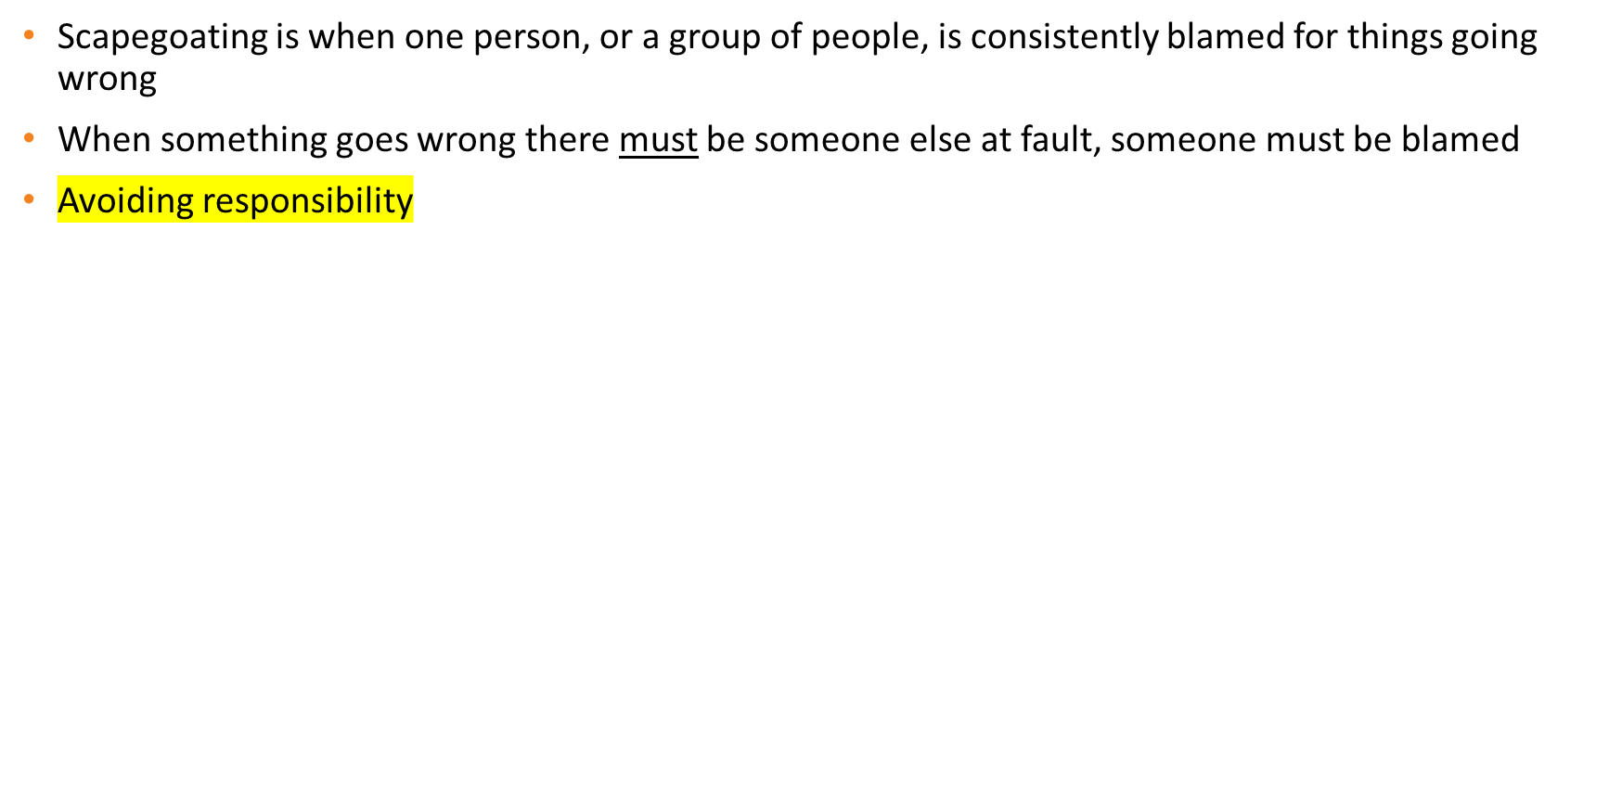
No Blaming and Scapegoating

Slide 17
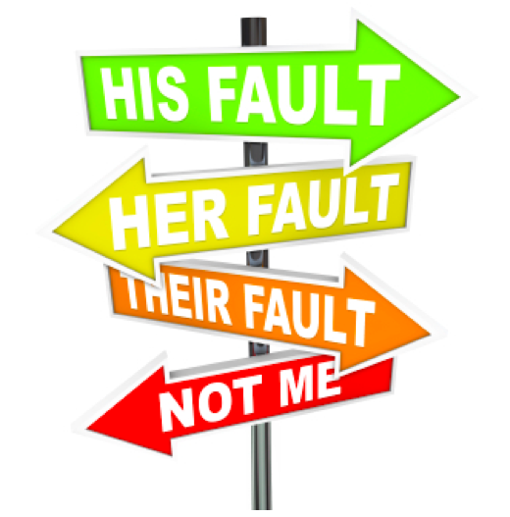
Reflecting on Blaming and Scapegoating

Slide 18
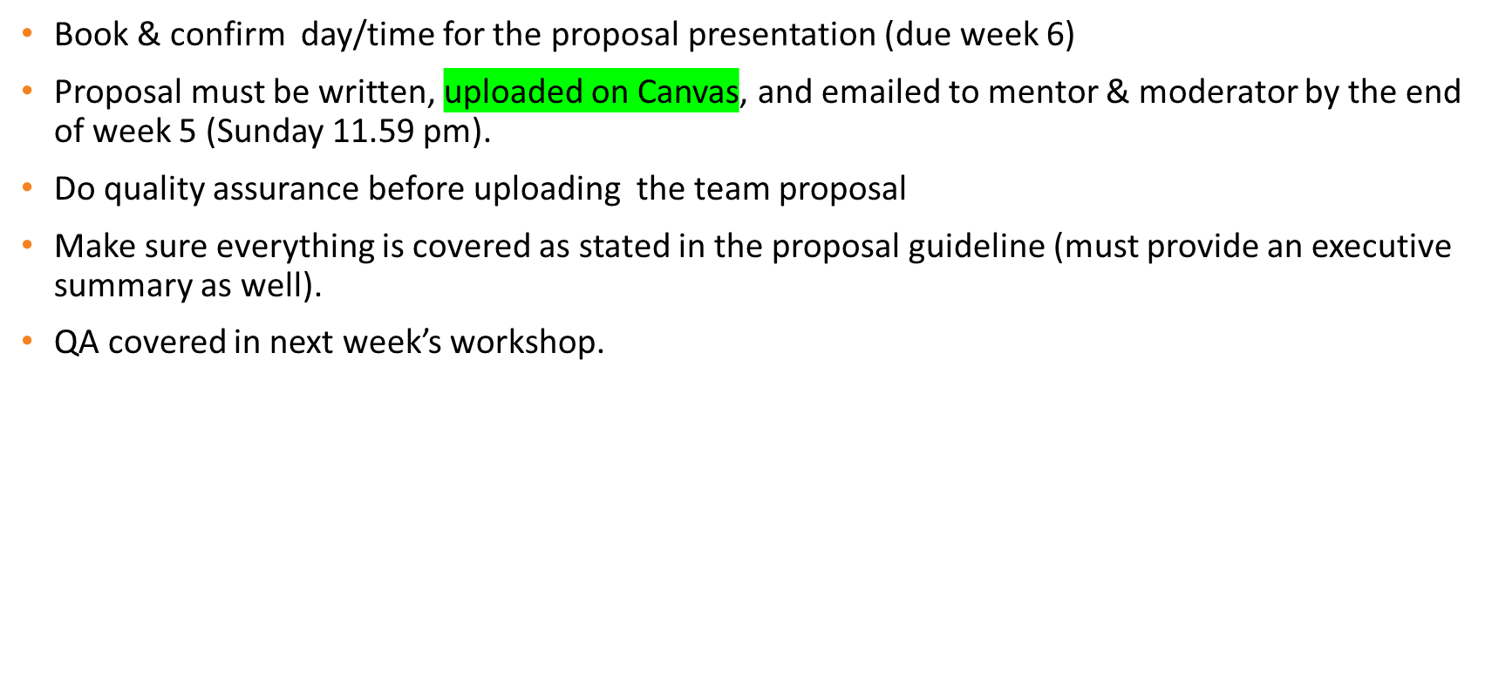
Schedule for next weeks

Slide 19
Questions?

